Slide 1
Domain-adversarial Training
Dr. Yan Yan

Slide 2
Transfer Learning - Overview
Source Data (not directly related to the task)
labelled
unlabeled
Fine-tuning
labelled
Multitask Learning
Target Data
Domain-adversarial training
unlabeled

Slide 3

Task description
Source data: $\left(x^{s},y^{s}\right)$
Target data: $\left(x^{t}\right)$
Training data
Same task, mismatch
Testing data
with label
without label

Slide 4
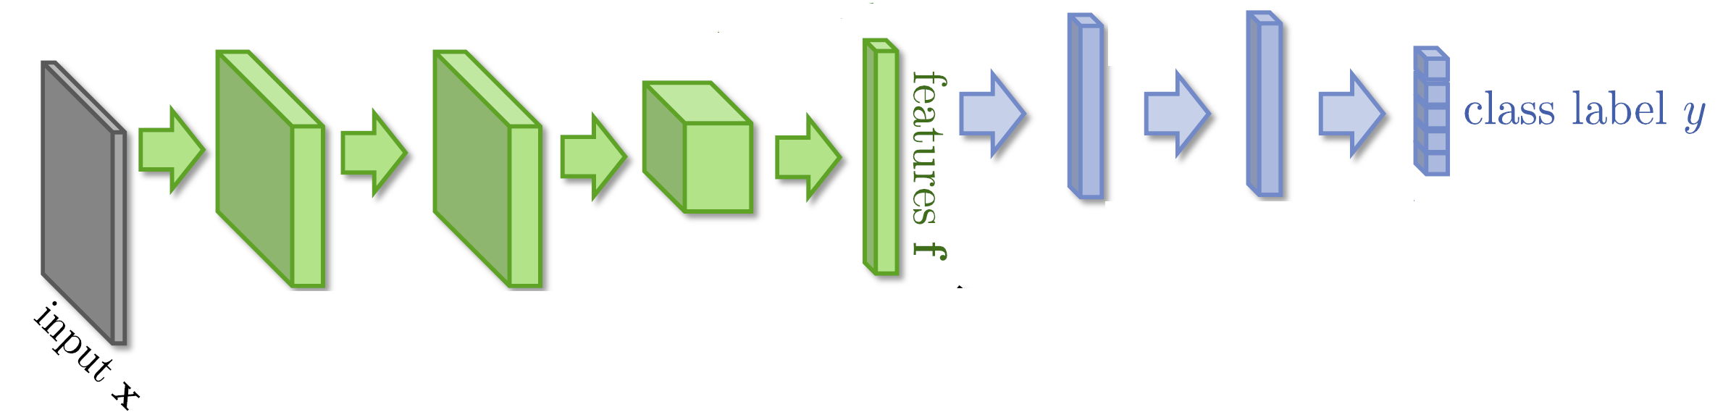


Domain-adversarial training

Slide 5
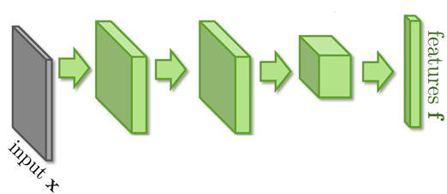
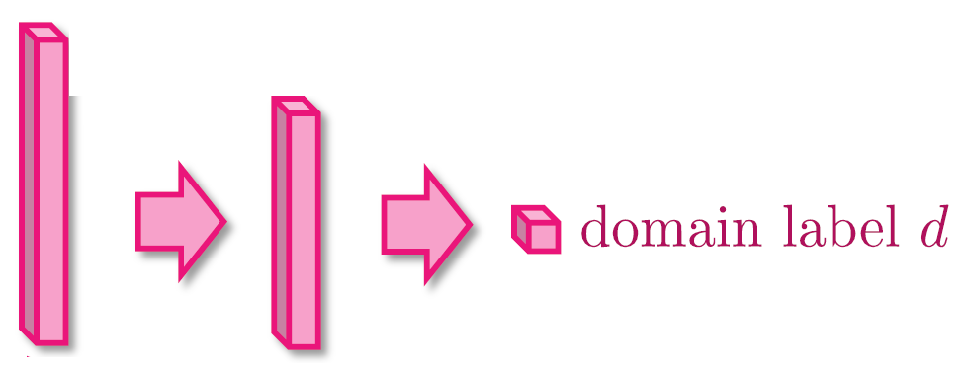


Domain-adversarial training
Similar to GAN
feature extractor
Too easy to feature extractor ……
Domain classifier

Slide 6
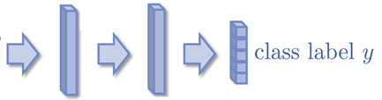
Domain-adversarial training
Maximize label classification accuracy + minimize domain classification accuracy
Maximize label classification accuracy
feature extractor
Label predictor
Domain classifier
Not only cheat the domain classifier, but satisfying label classifier at the same time
Maximize domain classification accuracy
This is a big network, but different parts have different goals.

Slide 7
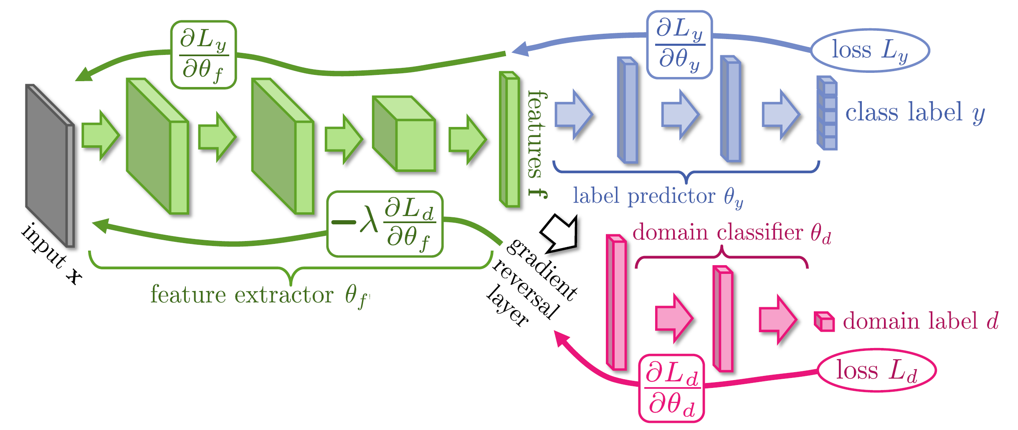
Domain-adversarial training
Domain classifier fails in the end
It should struggle ……
Yaroslav Ganin, Victor Lempitsky, Unsupervised Domain Adaptation by Backpropagation, ICML, 2015 Hana Ajakan, Pascal Germain, Hugo Larochelle, François Laviolette, Mario Marchand, Domain-Adversarial Training of Neural Networks, JMLR, 2016

Slide 8
Domain-adversarial training
Yaroslav Ganin, Victor Lempitsky, Unsupervised Domain Adaptation by Backpropagation, ICML, 2015
Hana Ajakan, Pascal Germain, Hugo Larochelle, François Laviolette, Mario Marchand, Domain-Adversarial Training of Neural Networks, JMLR, 2016

